Slide 1
SOLVING INVERSE PROBLEMS IN MEDICAL IMAGING WITH SCORE-BASED GENERATIVE MODELS
Yang Song˚, Liyue Shen˚, Lei Xing & Stefano Ermon, ICLR 2022
2차 논문 발표

Slide 2
목차
Recap
Implemented Code
Evaluation Results
Difficulties

Slide 3
Recap
Score Model
VE, VP
Euler-Maruyama Method
Main Topic: Conditional From Unconditional

Slide 4
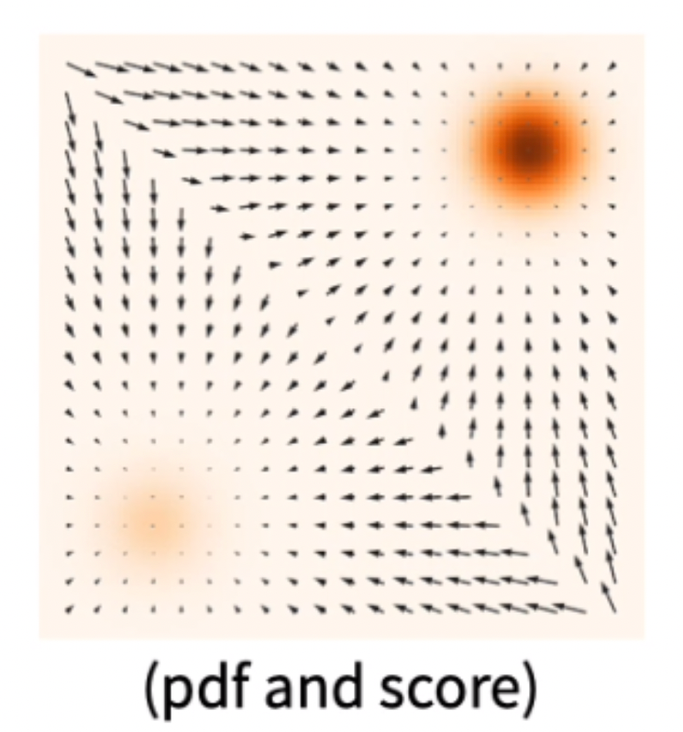

Score
평면 위의 점의 ‘점수’ = 데이터가 밀집된 곳을 가리킴
$∇_{x}log⁡(p_{t}\left(x\right))$

Slide 5



Score Model
Main Objective: $θ^{∗}=argmin E_{P(x)}\frac{1}{2}[{\left|∇_{x}logp\left(x\right)−s_{θ}\left(x\right)\right|}_{2}^{2}]$
Denoising With Langevin Dynamics: VE: Used Here
Denoising Diffusion Probabilistic Models: VP

Slide 6
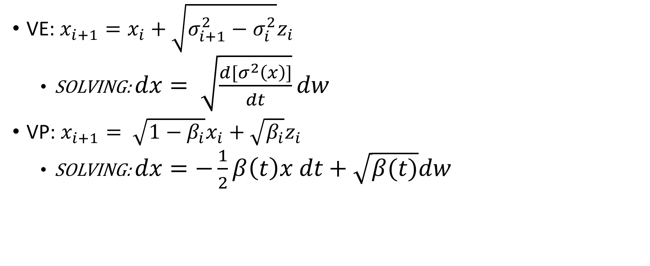
Score Model
VE: $x_{i+1}=x_{i}+\sqrt{σ_{i+1}^{2}−σ_{i}^{2}}z_{i}$
SOLVING: $dx= \sqrt{\frac{d[σ^{2}\left(x\right)]}{dt}}dw$
VP: $x_{i+1}= \sqrt{1−β_{i}}x_{i}+\sqrt{β_{i}}z_{i}$
SOLVING: $dx=−\frac{1}{2}β\left(t\right)x dt+\sqrt{β(t)}dw$
$$dx_{t}=f\left(t\right)x_{t}dt+g\left(t\right)dW_{t}$$

Slide 7
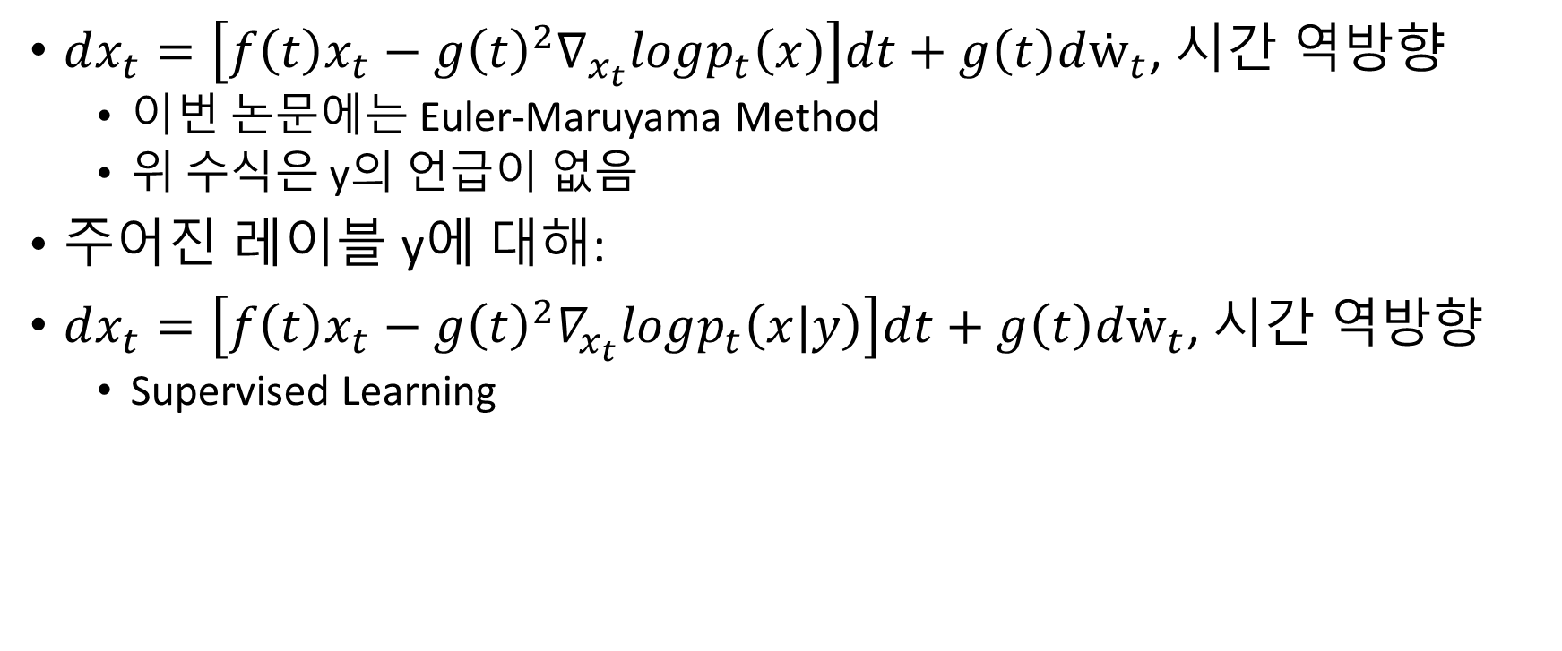
Solving SDE
$dx_{t}=\left[f\left(t\right)x_{t}−g{\left(t\right)}^{2}∇_{x_{t}}logp_{t}\left(x\right)\right]dt+g\left(t\right)dẇ_{t}$, 시간 역방향
이번 논문에는 Euler-Maruyama Method
위 수식은 y의 언급이 없음
주어진 레이블 y에 대해:
$dx_{t}=\left[f\left(t\right)x_{t}−g{\left(t\right)}^{2}∇_{x_{t}}logp_{t}\left(x|y\right)\right]dt+g\left(t\right)dẇ_{t}$, 시간 역방향
Supervised Learning

Slide 8
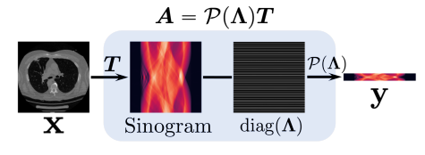
메인 주제
A, P, T, Λ 에 대해:

Slide 9
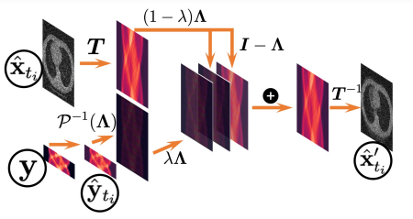
메인 주제
X와 y를 따로 놓고 계산한 뒤 합치기 위해 새 항목을 추가

Slide 10
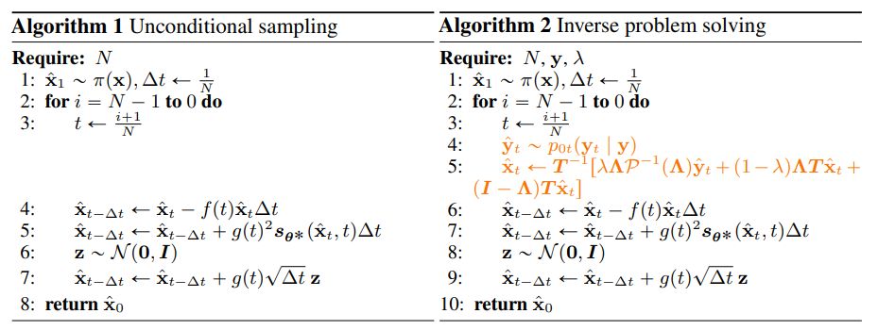
메인 주제
$$s.t. P^{−1}=R^{m}→R^{n}:\text{Λ}\text{Tu} \text{=}\text{Λ}P^{−1}\left(\text{Λ}\right)y_{t}$$

Slide 11
Implementation
Main Topic
Euler-Maruyama
Score Model

Slide 12
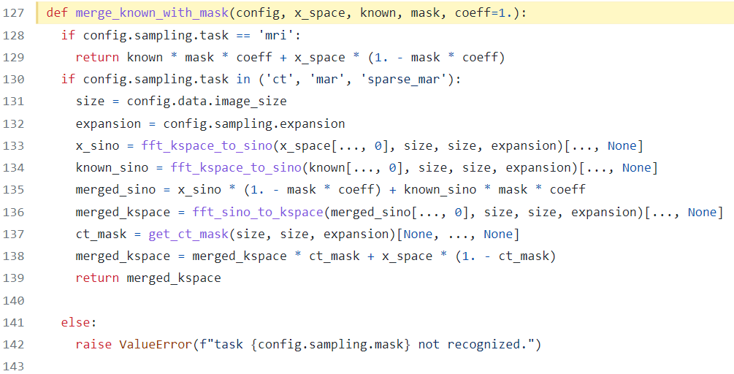
Impl-Main Topic
In cs.py

Slide 13
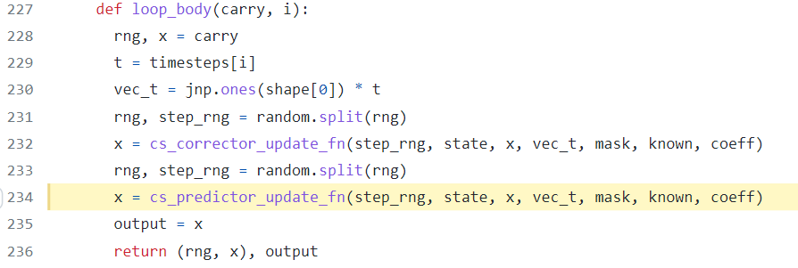
Impl-Main Topic
In cs.py

Slide 14
Impl-Main Topic
In cs.py

Slide 15
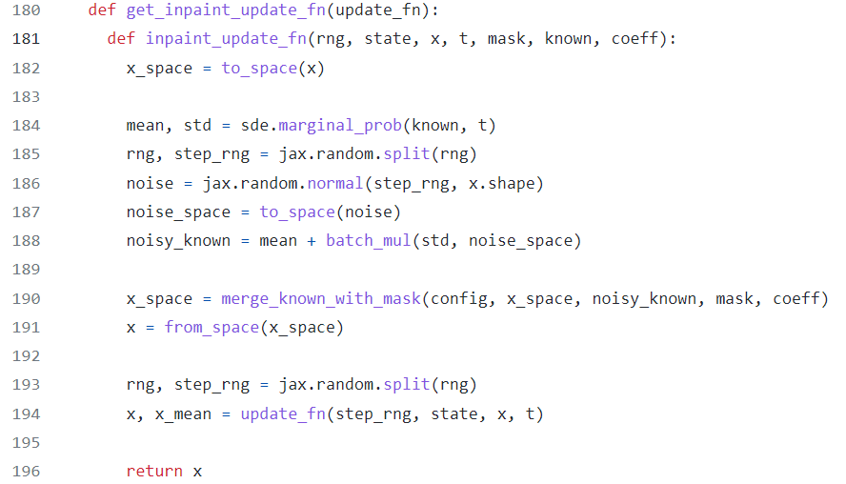
Impl-Main Topic
In cs.py

Slide 16
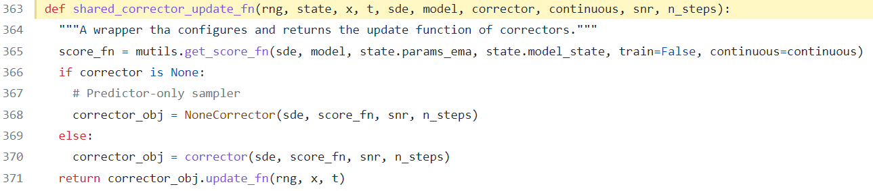
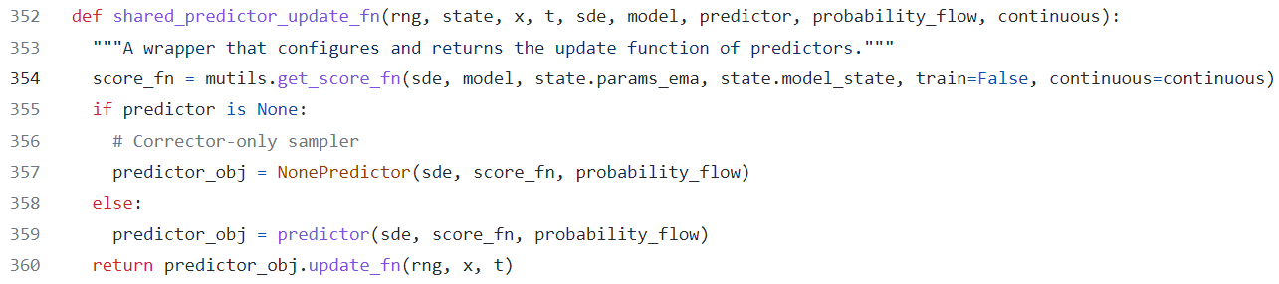
Impl-Main Topic
In sampling.py

Slide 17
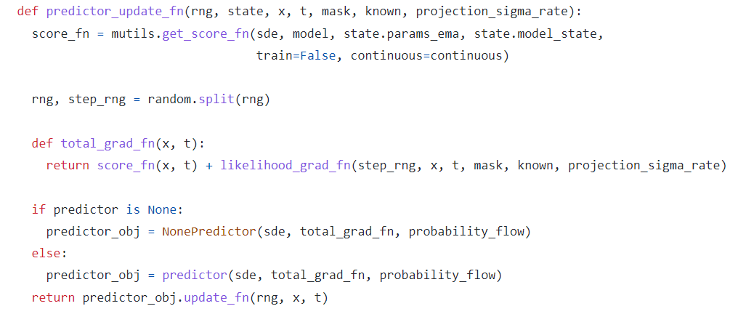
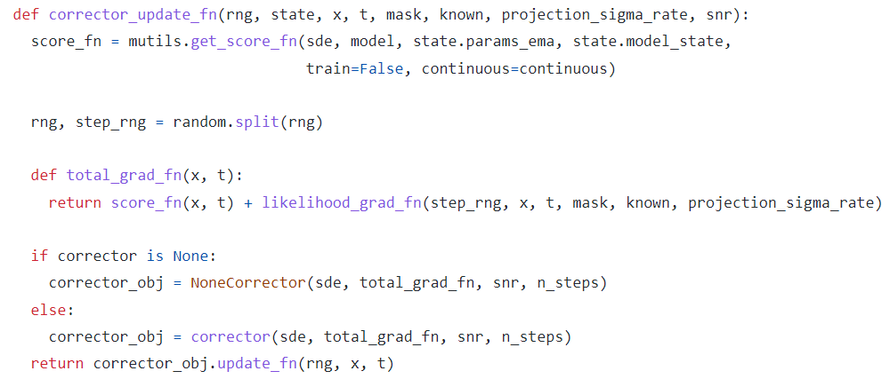
Impl-Main Topic

Slide 18
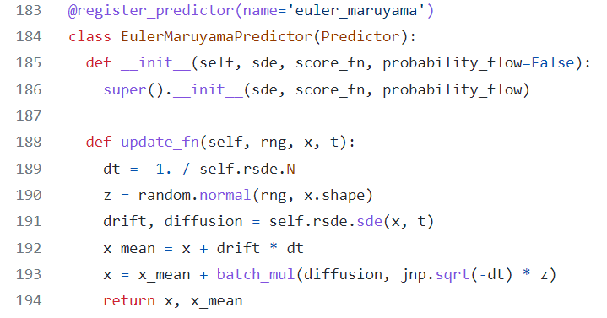
Impl-Euler-Maruyama
In sampling.py

Slide 19
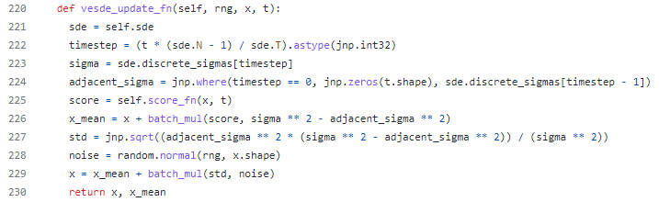
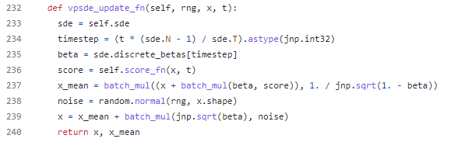
Impl-Euler-Maruyama
In sampling.py

Slide 20
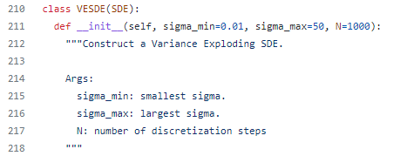
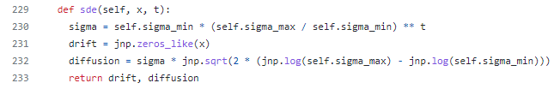

Impl-Euler-Maruyama
In sde_lib.py

Slide 21
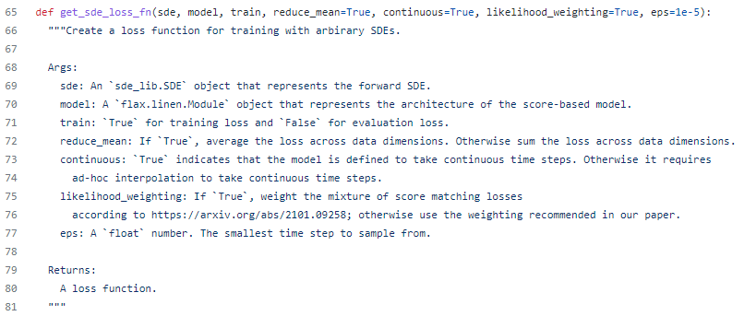
Impl-Score Model
In losses.py

Slide 22

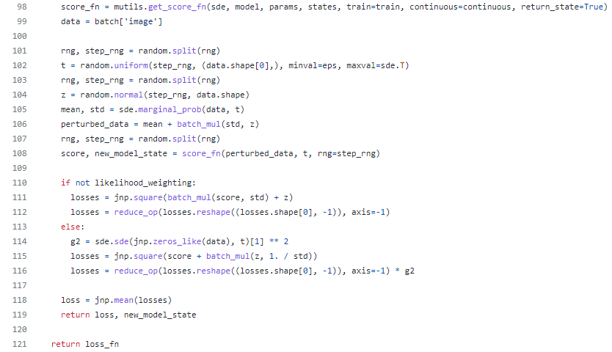
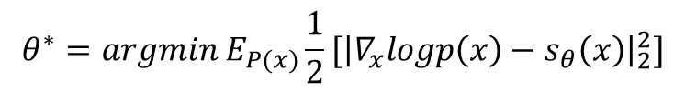
Impl-Score Model
In losses.py
$$θ^{∗}=argmin E_{P(x)}\frac{1}{2}[{\left|∇_{x}logp\left(x\right)−s_{θ}\left(x\right)\right|}_{2}^{2}]$$

Slide 23
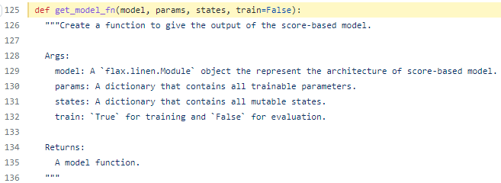
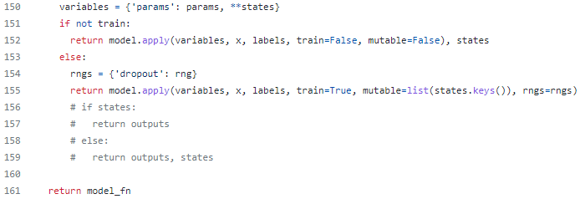
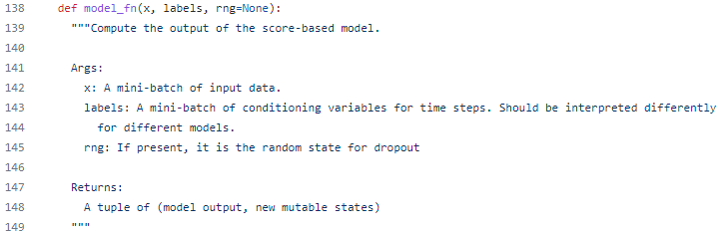
Impl-Score Model
In models/utils.py

Slide 24
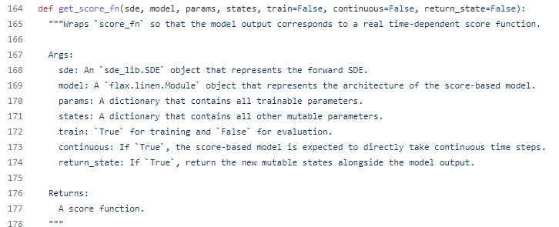
Impl-Score Model
In models/utils.py

Slide 25
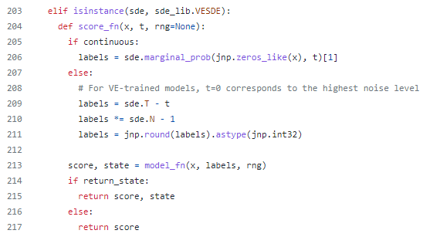
Impl-Score Model
In models/utils.py

Slide 26
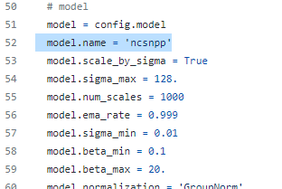
Impl-Score Model
In configs/ve/any_file

Slide 27
NCSN
Noise Conditional Score Network
Noise가 Condition이 되는 Perturbed Data로부터 Score 학습
Annealed Langevin Dynamics
2019 Song et. al, 2020 Song et. al
σ가 매우 작아야 잘 작동

Slide 28
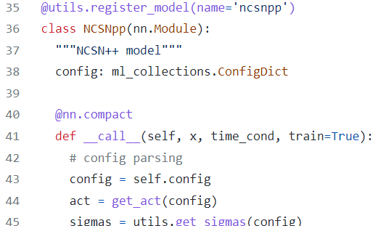
Impl-Score Model
In models/ncsnpp.py

Slide 29
Evaluation Results
psnrs
ssims
psnrs_mask
ssims_mask
psnrs_mask_hist
ssims_mask_hist
37.654
0.959
37.656
0.959
34.099
0.949

Slide 30
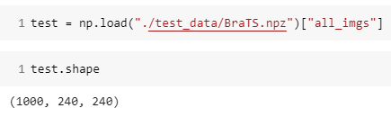

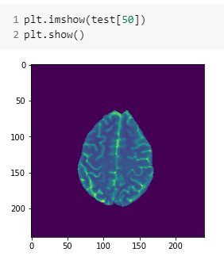
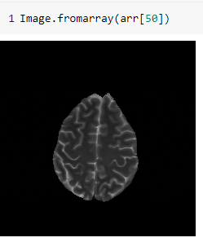
Evaluation Results

Slide 31
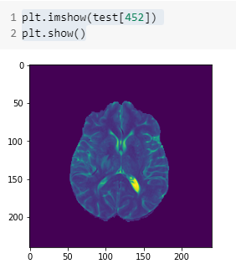
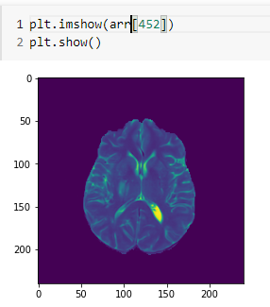
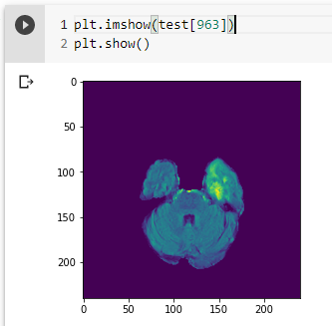
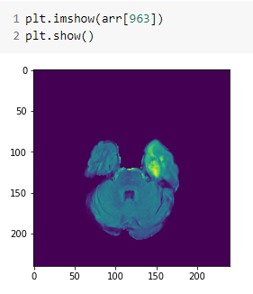
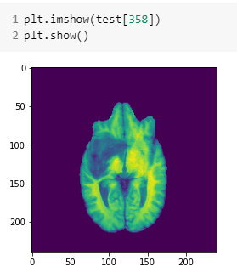
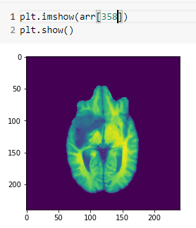
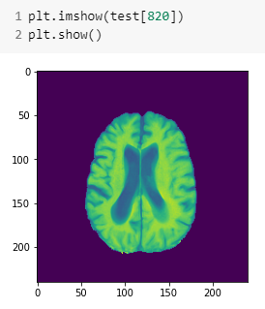
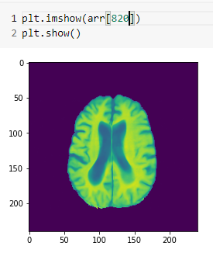
Evaluation Results

Slide 32

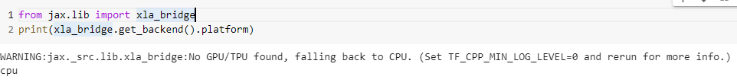
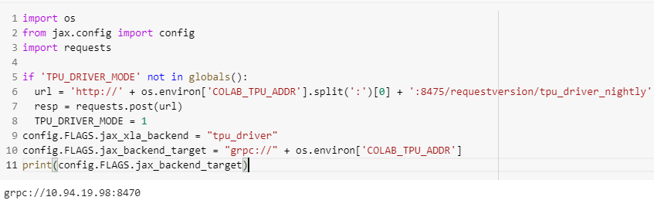
Difficulties
Low Jax/Flax Version
만악의 근원

Slide 33
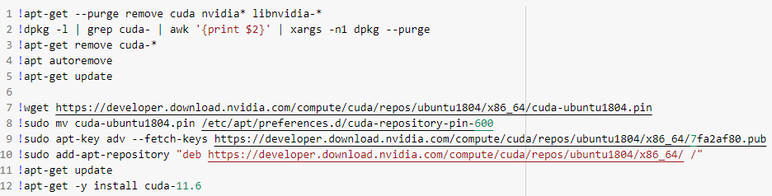
Difficulties
Low Jax/Flax Version
만악의 근원

Slide 34
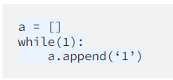
Difficulties
Low Jax/Flax Version
만악의 근원
Heavy RAM Usage
Tweak Configs +
No Train Data Available
Removed from TF-Datasets?

Slide 35
References
https://arxiv.org/abs/2011.13456
https://wandb.ai/ucalyptus/ScoreGM/reports/Inject-Noise-to-Remove-Noise-A-Deep-Dive-into-Score-Based-Generative-Modeling-Techniques--Vmlldzo1OTE2NDg
https://ivdevlog.tistory.com/8

